Slide 1

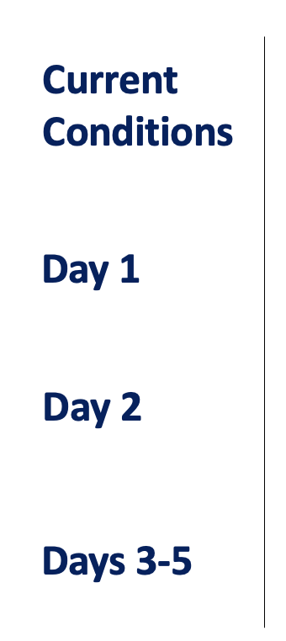
CPEX-CV Forecast
July 18, 2022
Shun-Nan W., Ben Rodenkirch
XXX.
AEW trough arrives Sal. Moist air rolls into the east of Sal dust. Strong squall-line like convergence occurs in the south of Sal island. ITCZ at around 8-10N with higher precipitation off the West African coast.
AEW propagate westward. Dusty air is alleviated over the Eastern Atlantic and cut to two group. ITCZ-contributed precipitation weakens.
Another AEW propagate offshore, and strong low-level jet occurs around Sal island. Sal dust keeps accumulating around the West African coastline between 15-25N.

Slide 2
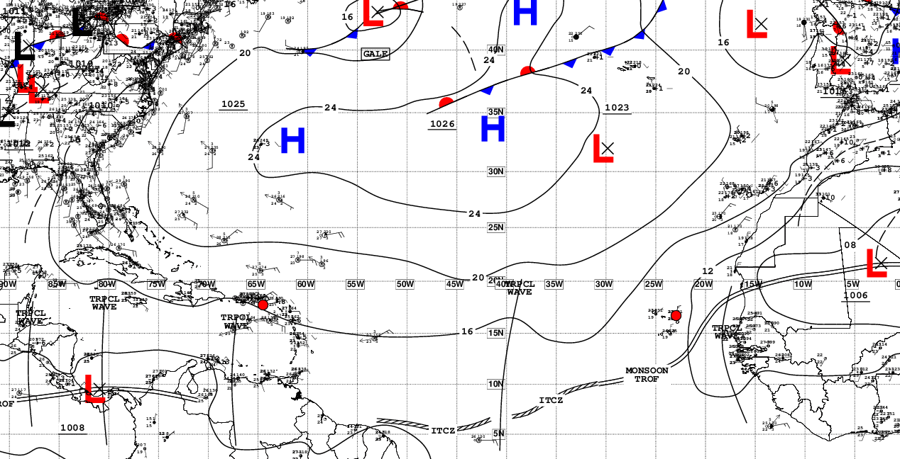
Current Conditions – Synoptic View
NHC Surface Analysis

Slide 3
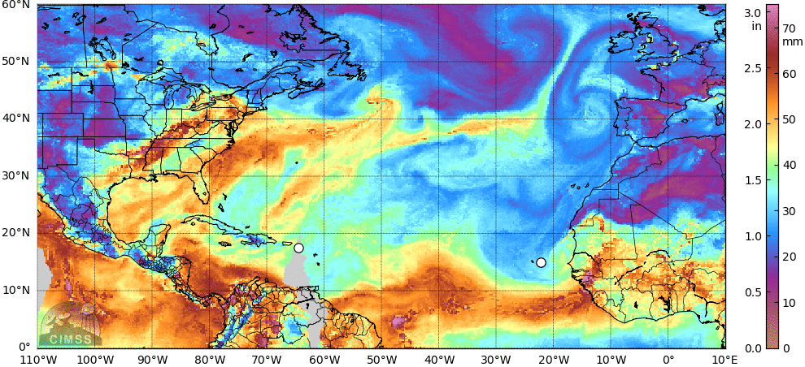
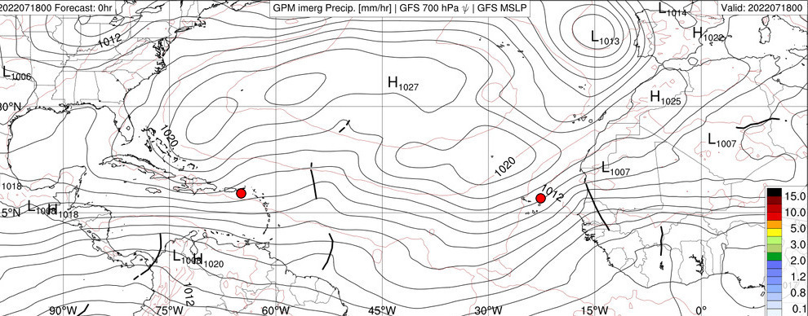
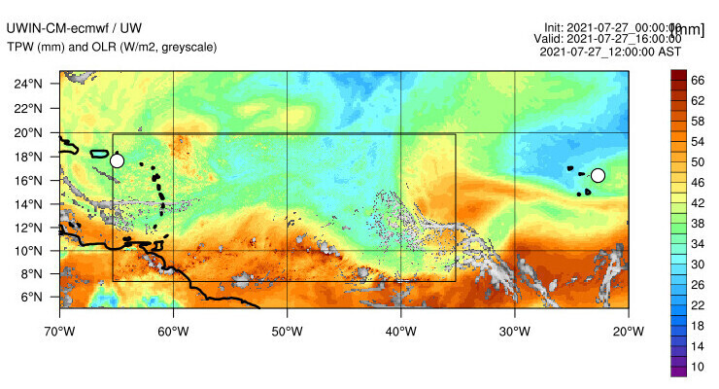
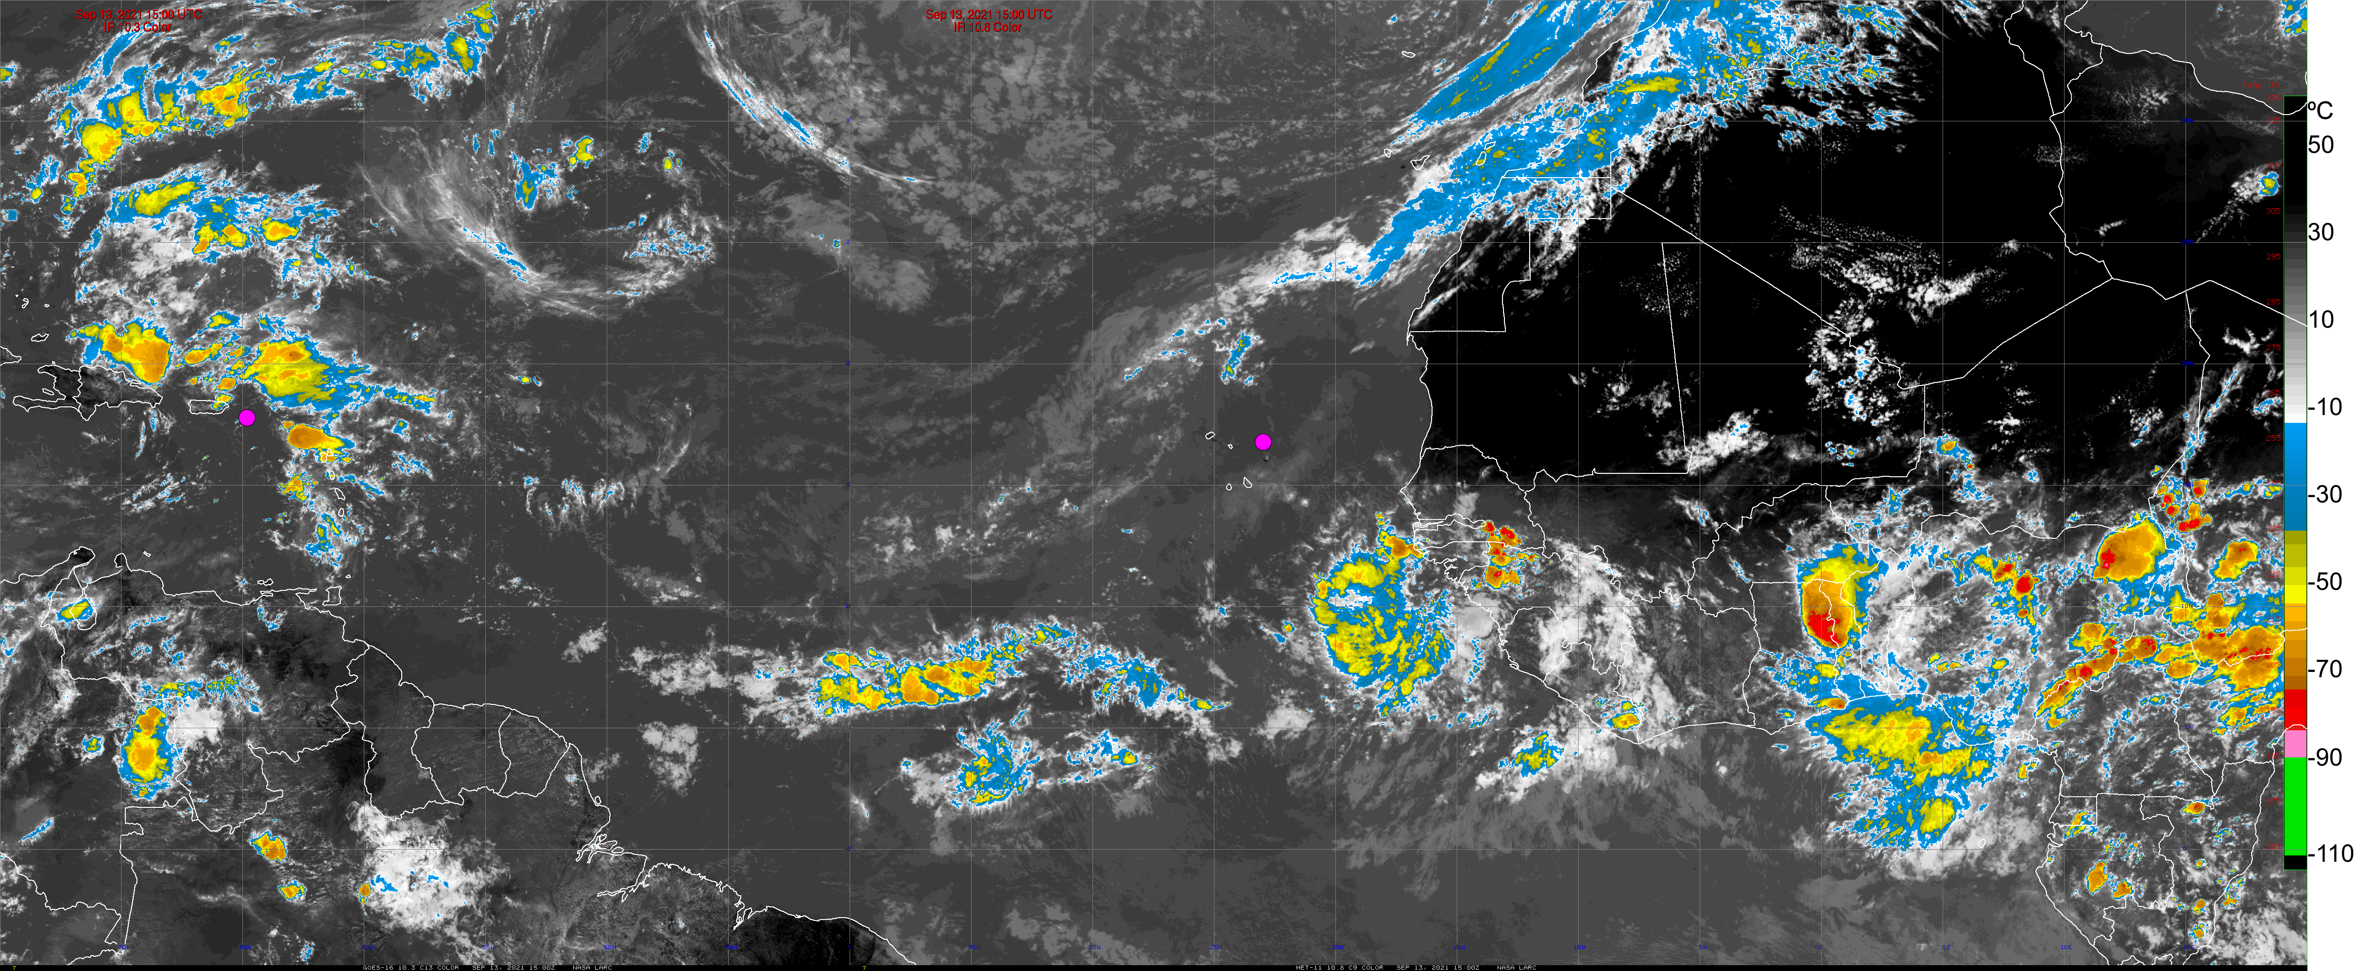
Current Conditions – ITCZ and AEW
Total Precipitable Water
IMERG Rain Rate, MSLP, Waves
Model OLR, TPW
GOES-16 / Meteosat-11 IR

Slide 4
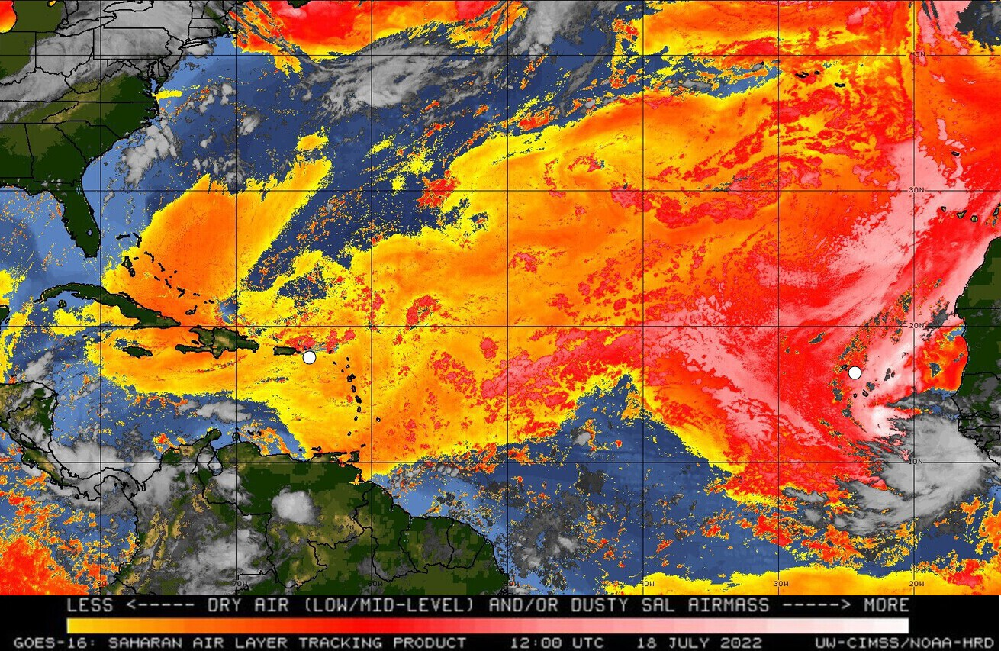
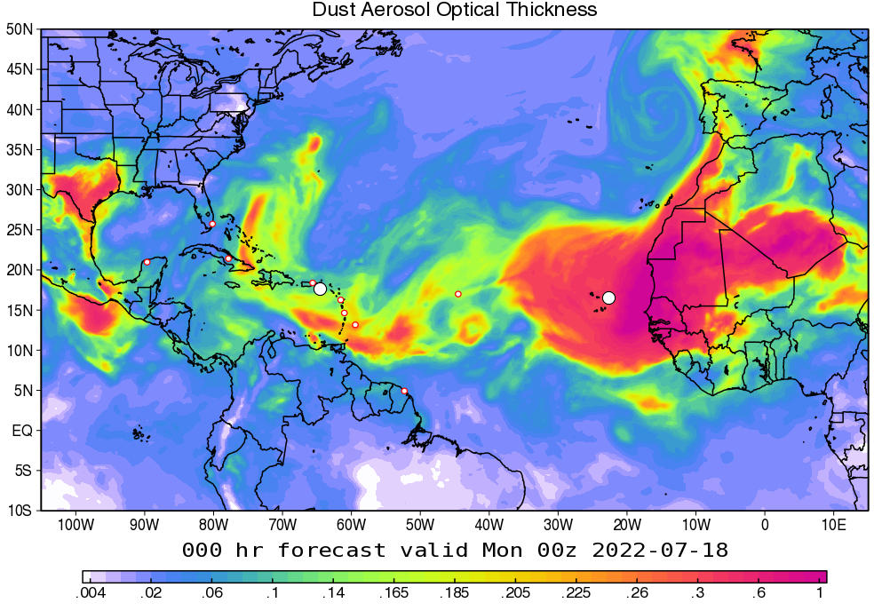
Current Conditions – Dust and Aerosols
SAL (split window)
Dust Aerosol Optical Thickness - GEOS

Slide 5
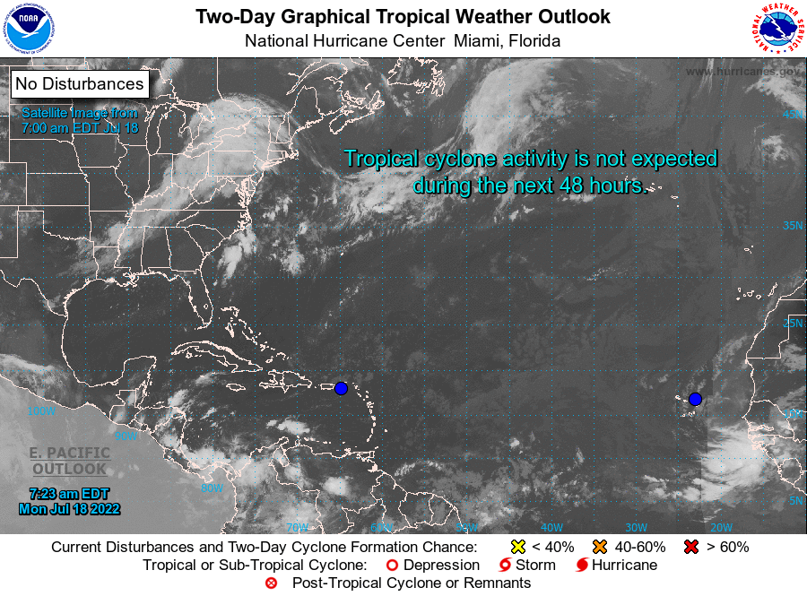
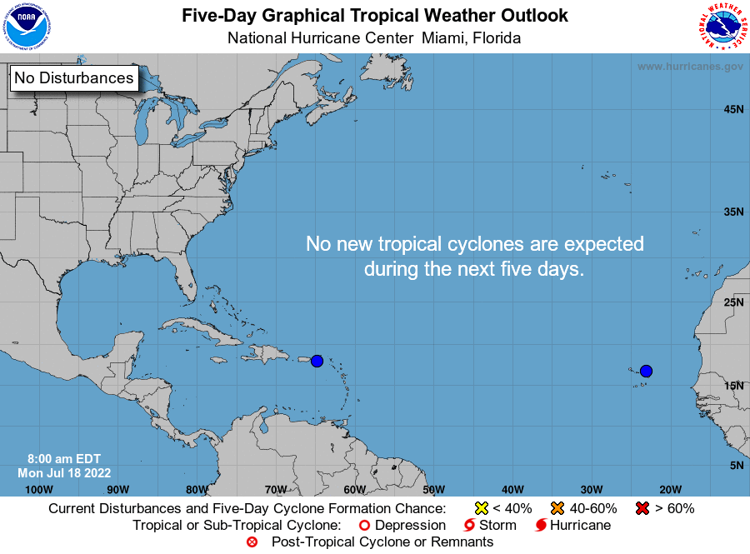
NHC Tropical Atlantic Outlook
(July 29 & Aug. 1, 2021)
2-day Outlook
5-day Outlook

Slide 6
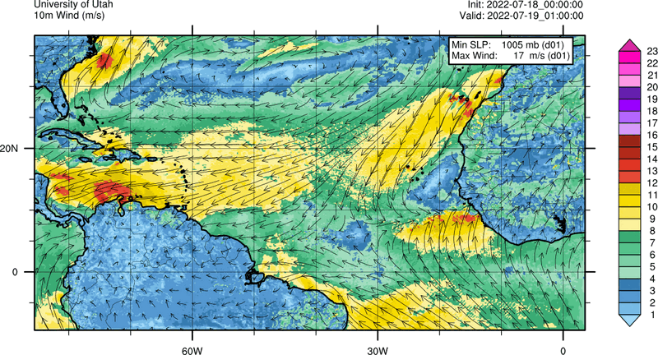
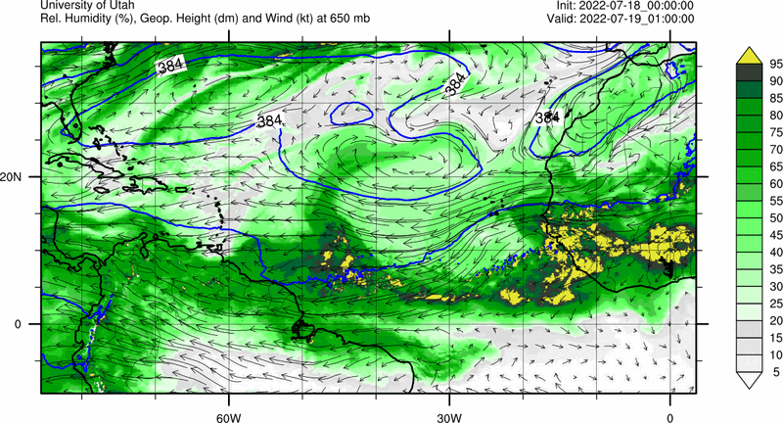
Forecast – day 1
(July 28, 2021)
10m Winds
Mid-level RH, Geopotential Height, Winds

Slide 7
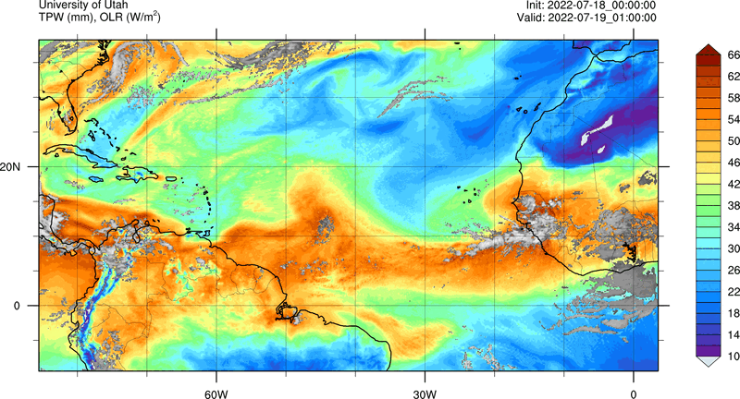
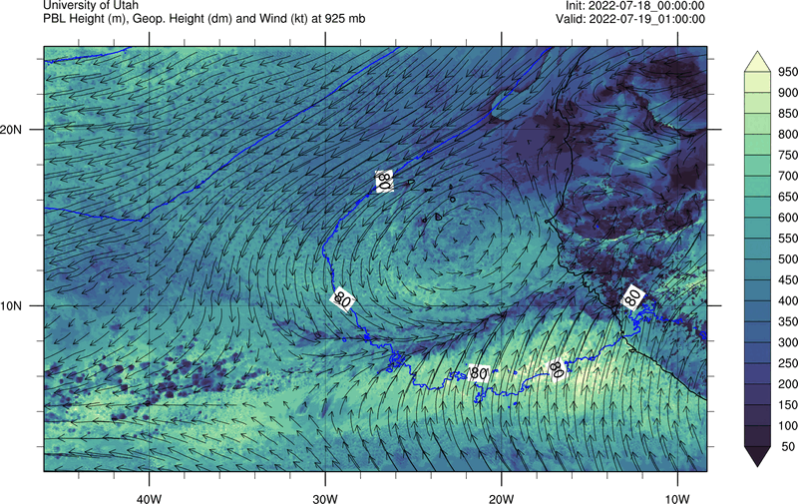
Forecast – day 1
(July 28, 2021)
TPW, OLR
PBL height

Slide 8
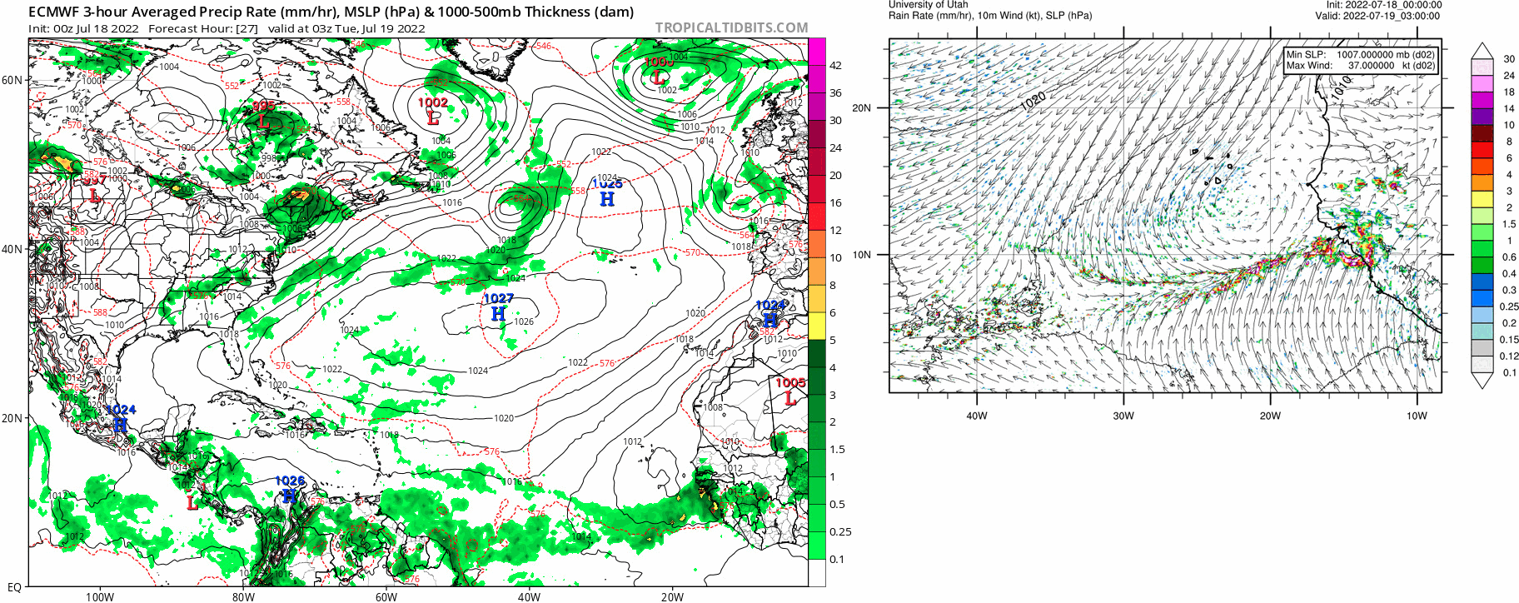
Forecast – day 1
(July 28, 2021)
10m Winds, Rain – ECMWF
10m Winds, Rain – UTAH

Slide 9
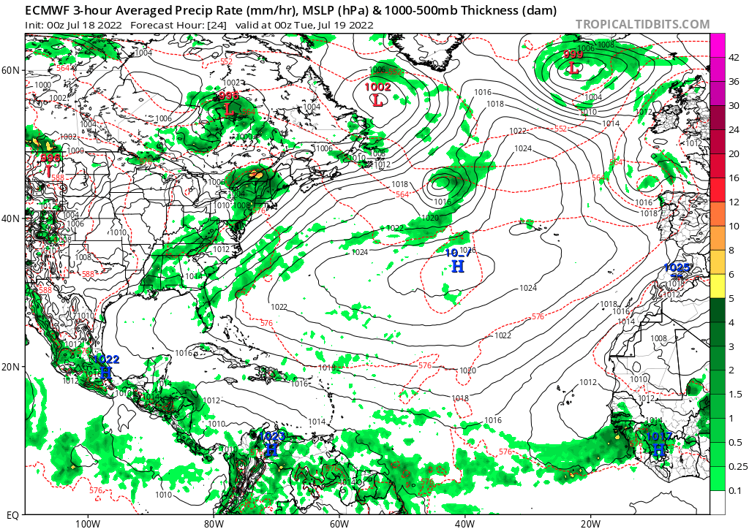
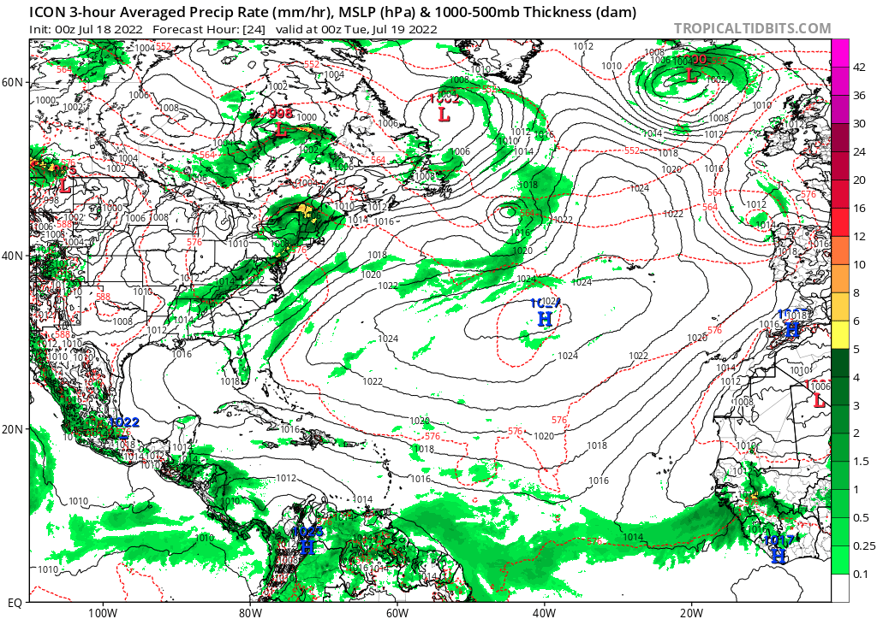
Forecast – day 1
(July 28, 2021)
10m Winds, Rain – ECMWF
10m Winds, Rain – ICON

Slide 10
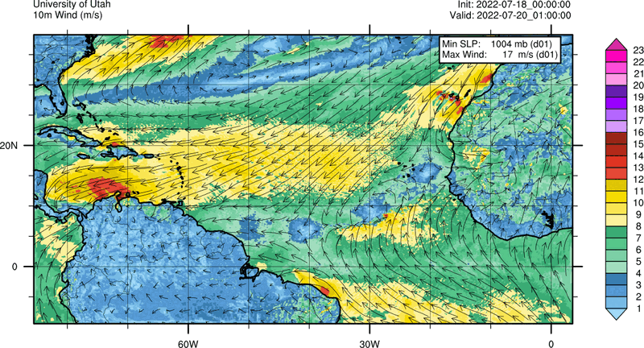
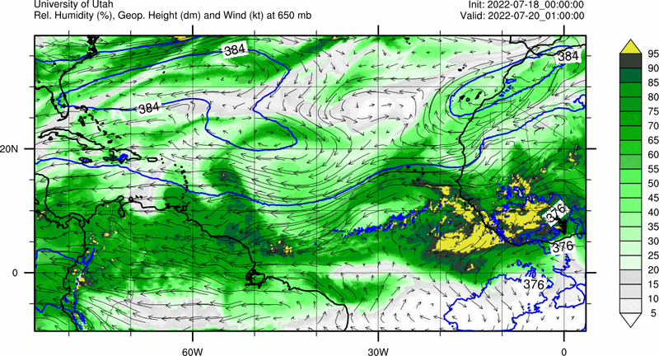
Forecast – day 2
(July 28, 2021)
10m Winds
Mid-level RH, Geopotential Height, Winds

Slide 11
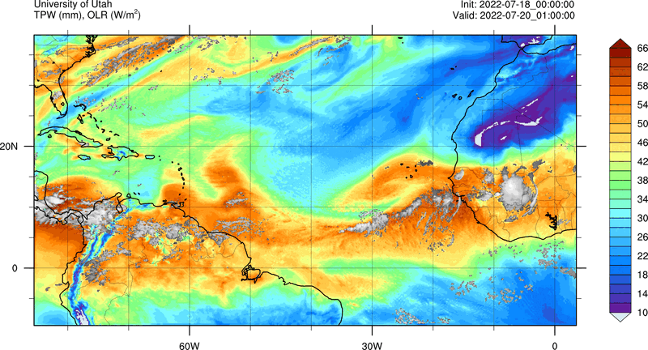
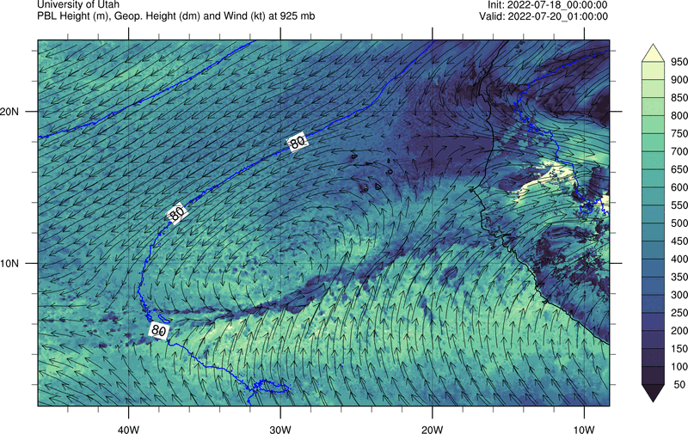
Forecast – day 2
(July 28, 2021)
TPW, OLR
PBL height

Slide 12
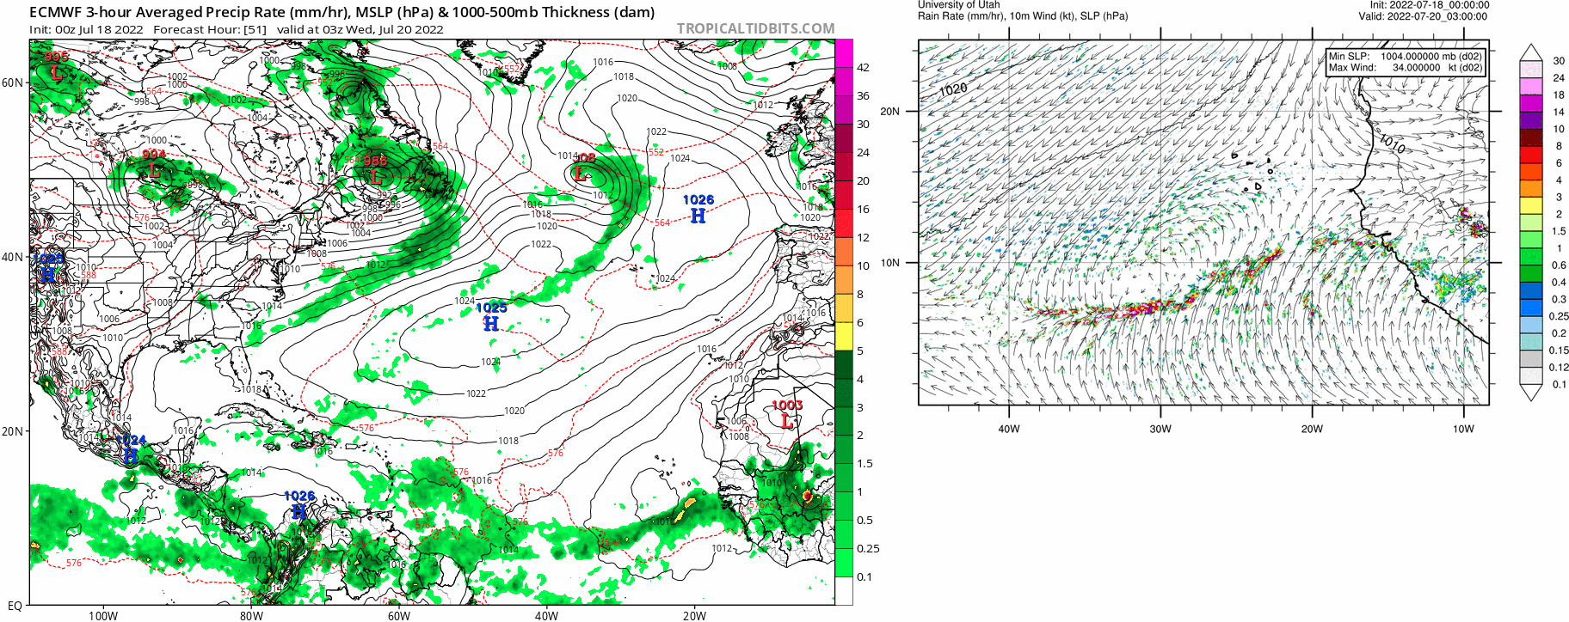
Forecast – day 2
(July 28, 2021)
10m Winds, Rain – ECMWF
10m Winds, Rain – UTAH

Slide 13
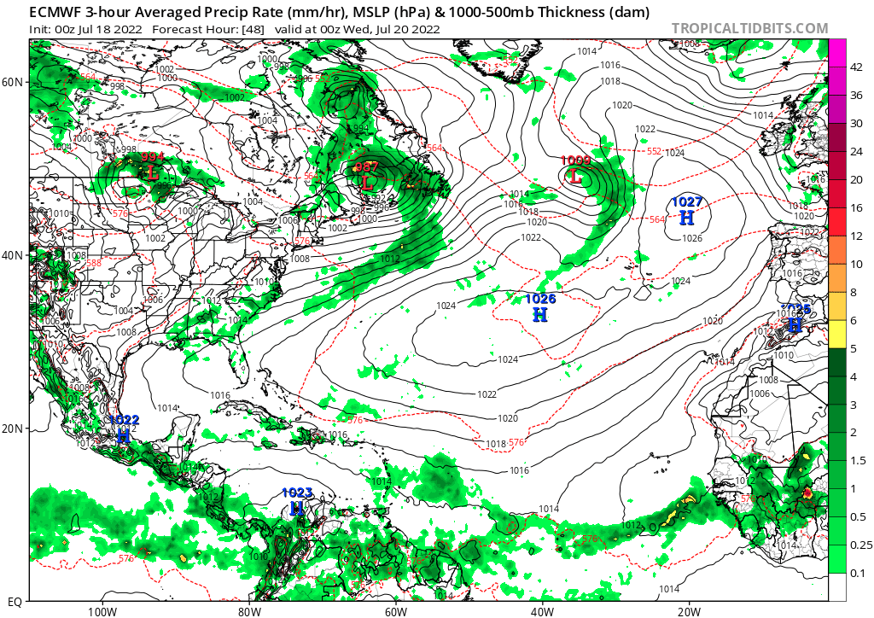
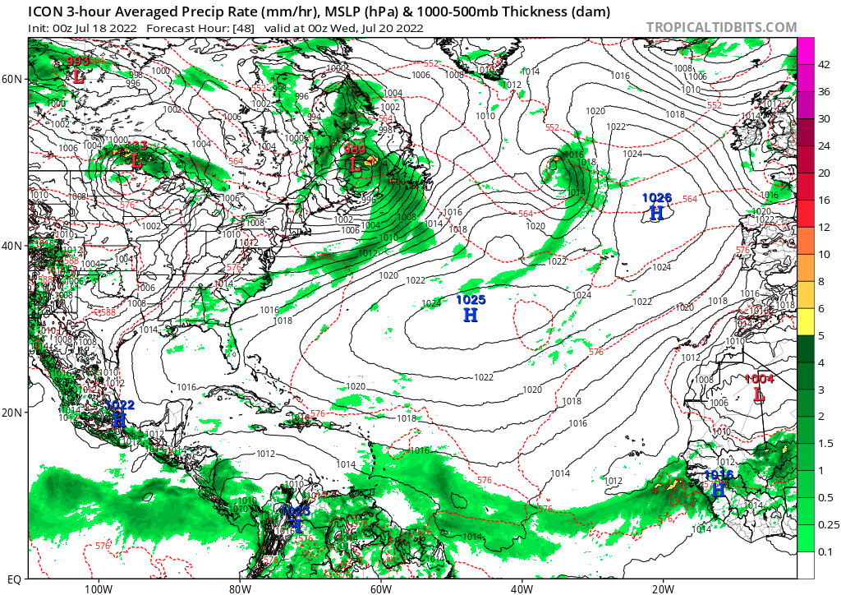
Forecast – day 2
(July 28, 2021)
10m Winds, Rain – ECMWF
10m Winds, Rain – ICON

Slide 14
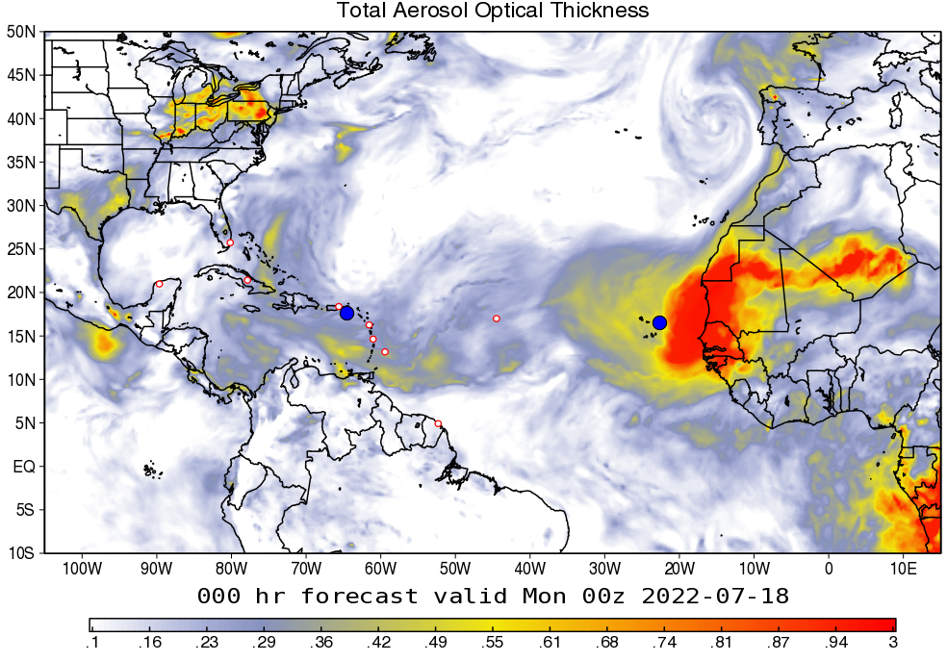
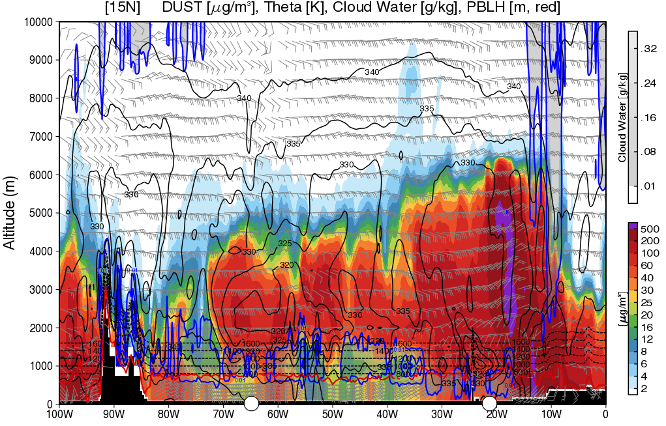
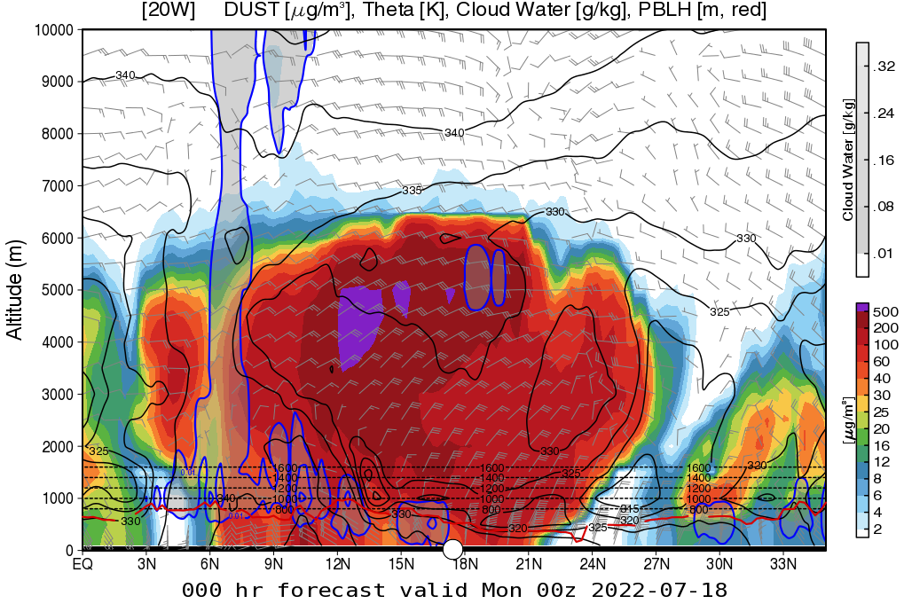
Dust and Aerosols - Current
(July 27, 2021)
Total AOT - GEOS
Dust cross-section at 15°N
Dust AOT - GEOS
Dust cross-section at 20°W

Slide 15
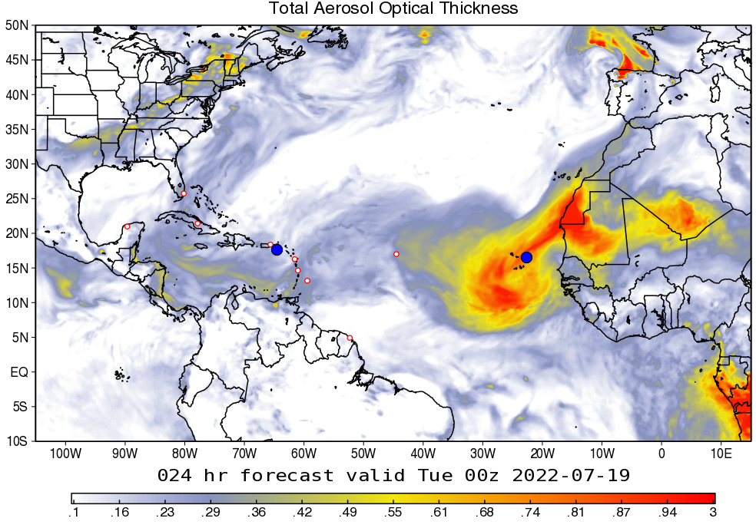
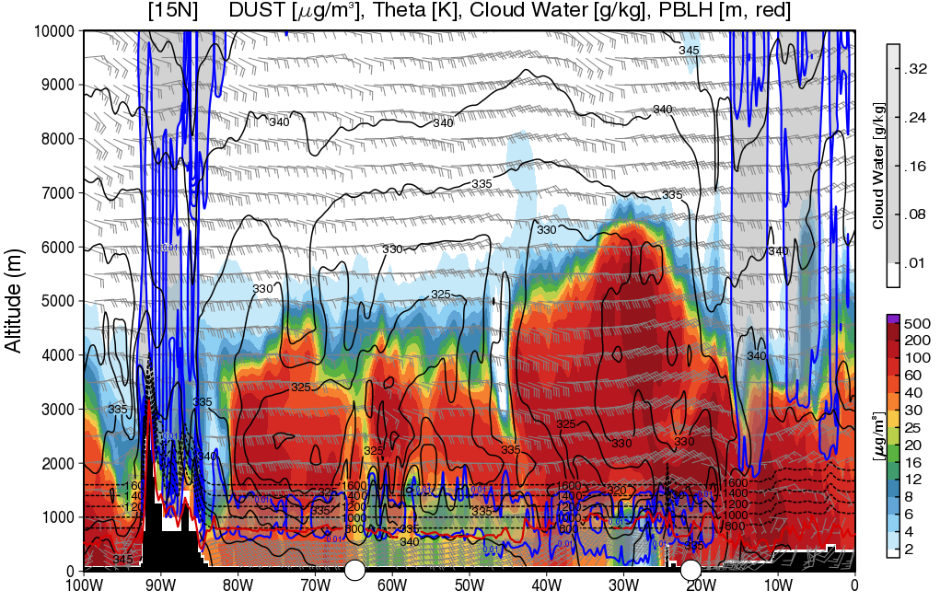
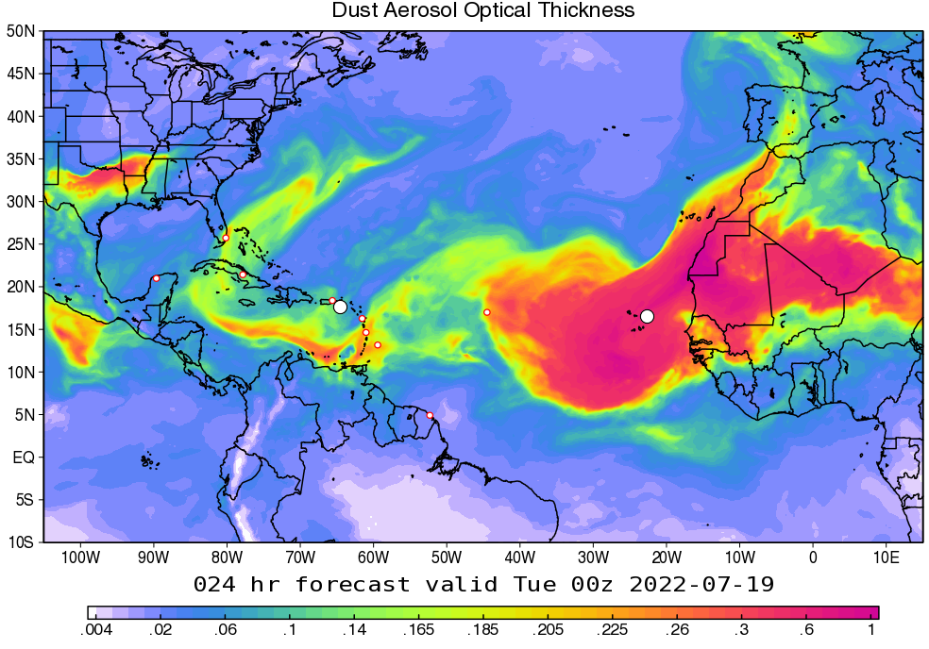
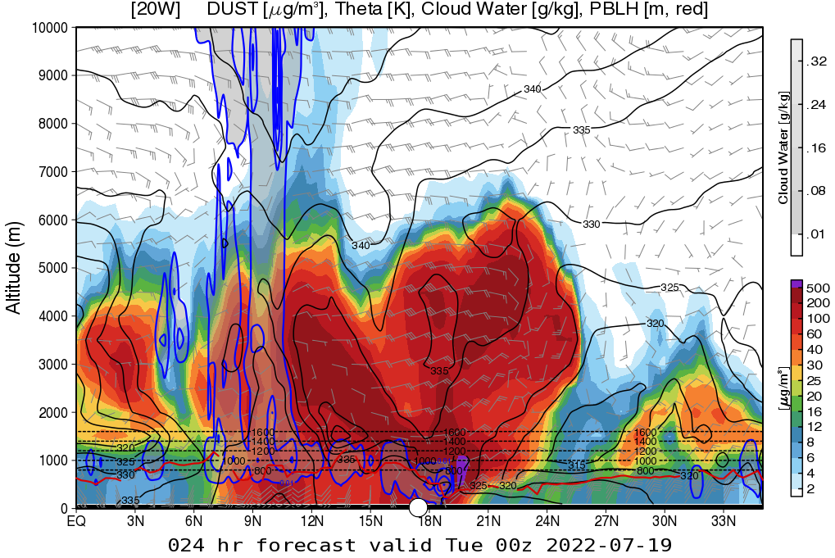
Dust and Aerosols - Day 1
(July 28, 2021)
Total AOT - GEOS
Dust cross-section at 15°N
Dust AOT - GEOS
Dust cross-section at 20°W

Slide 16
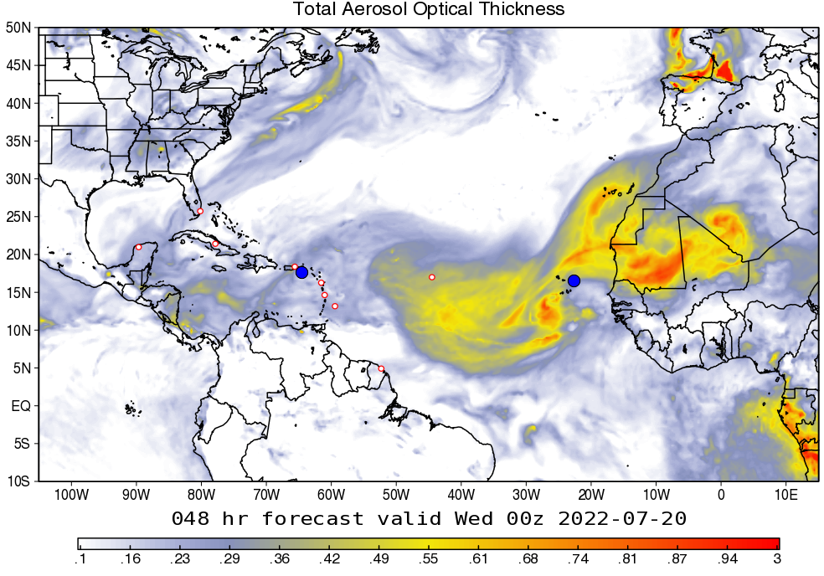
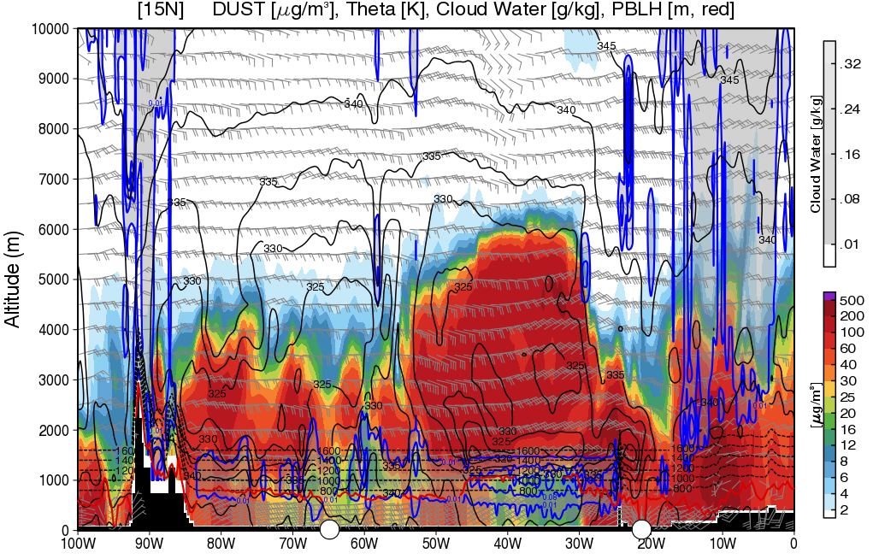
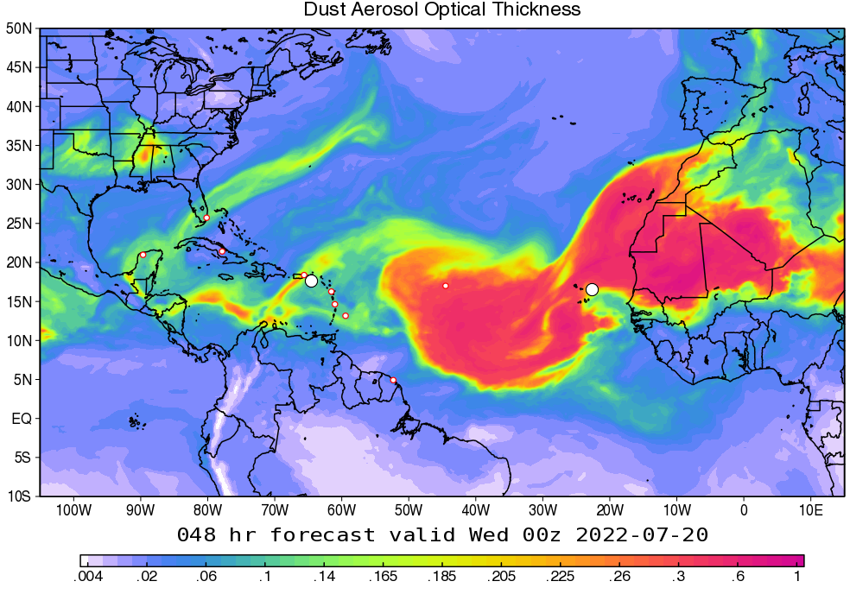
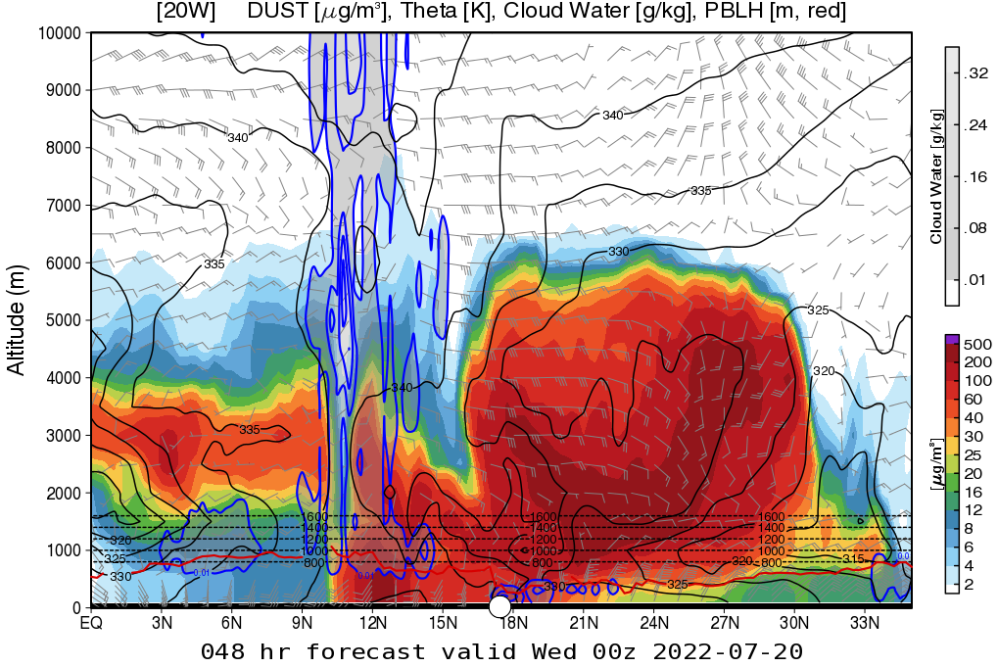
Dust and Aerosols - Day 2
(July 29, 2021)
Total AOT - GEOS
Dust cross-section at 15°N
Dust AOT - GEOS
Dust cross-section at 20°W

Slide 17
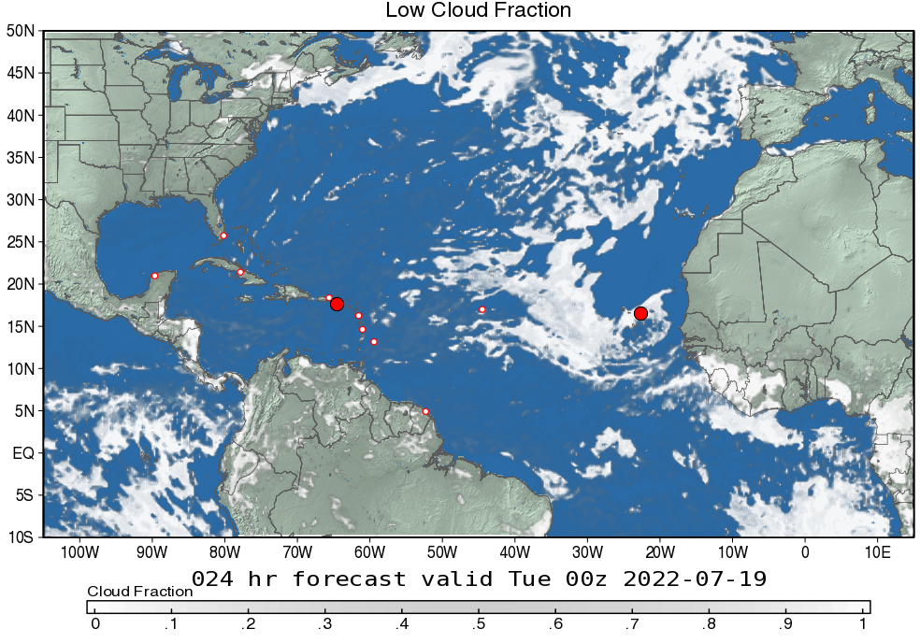
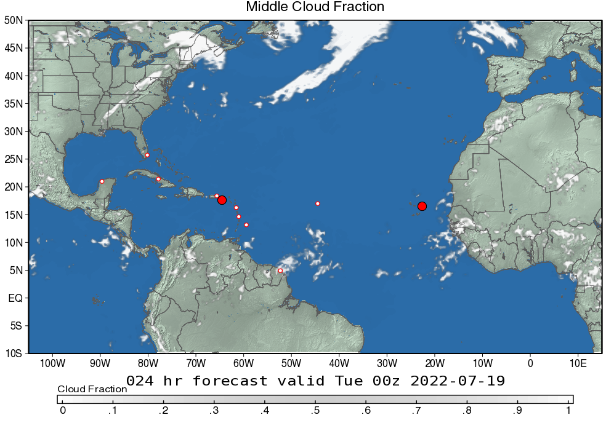
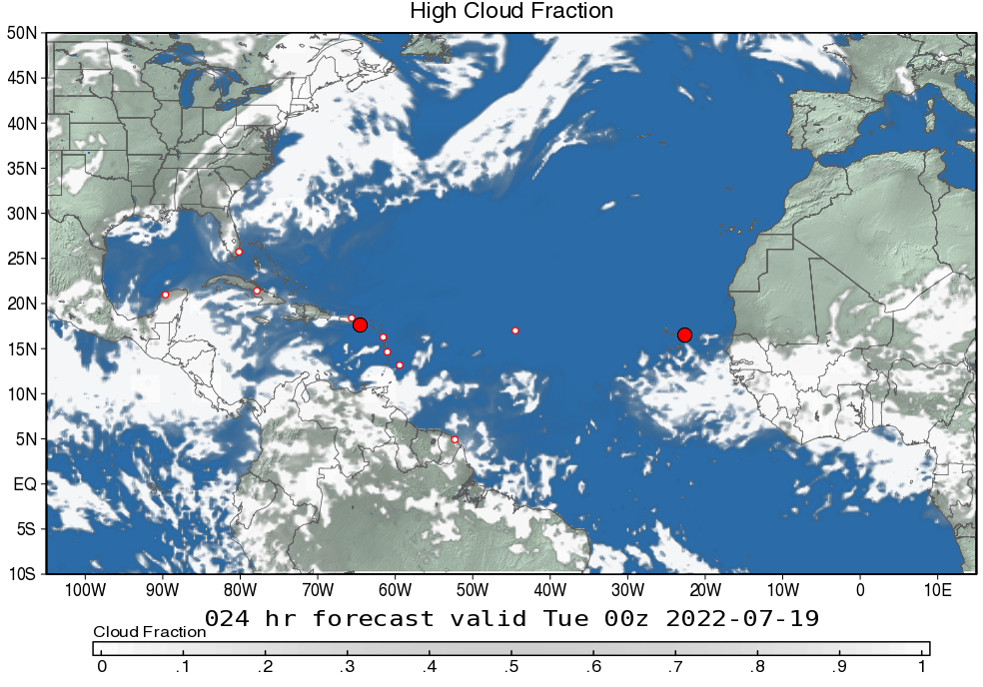
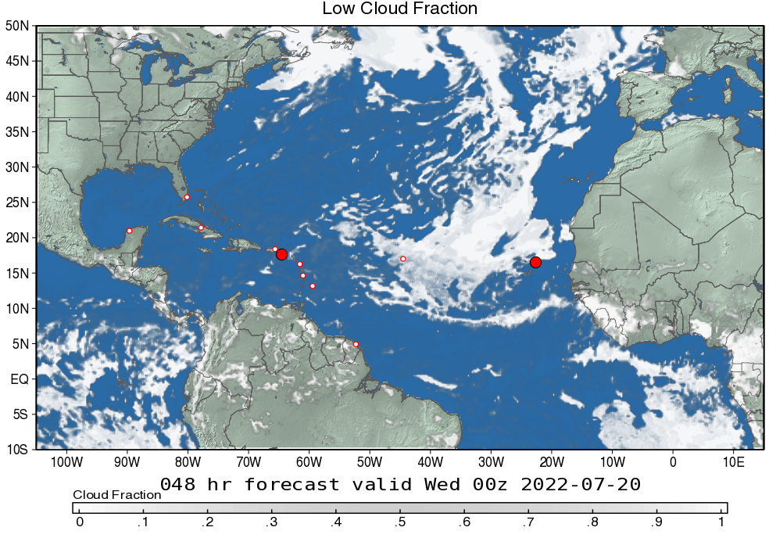
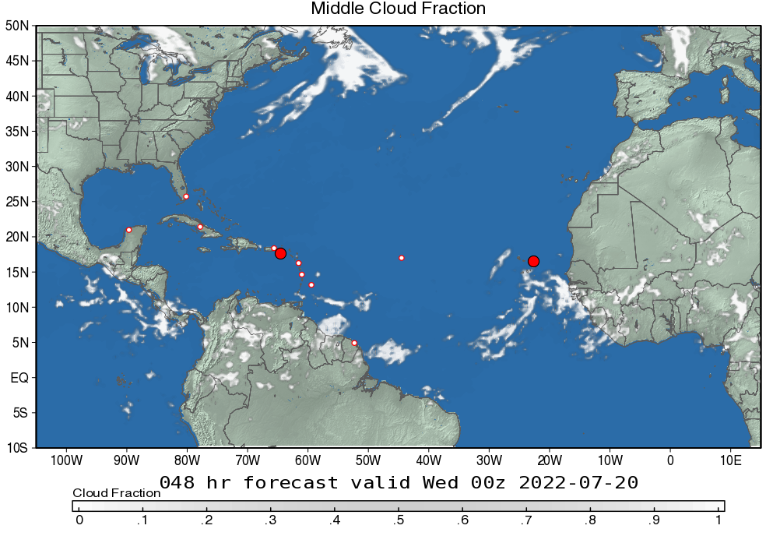
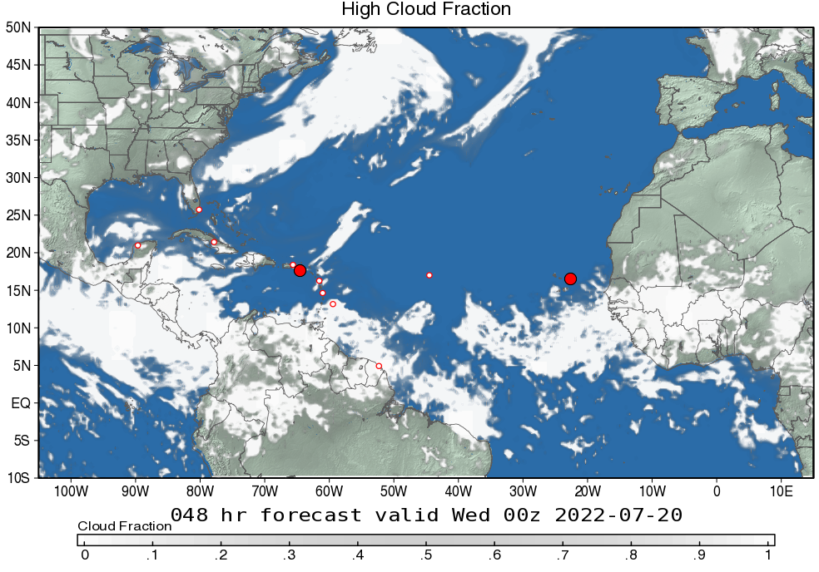
Cloud Fraction – days 1 & 2
(July 28 & 29, 2021)
Below 700 mb
400 - 700 mb
Above 400 mb
Day 1
Low cloud fraction
Middle cloud fraction
High cloud fraction
Day 2
Low cloud fraction
Middle cloud fraction
High cloud fraction

Slide 18
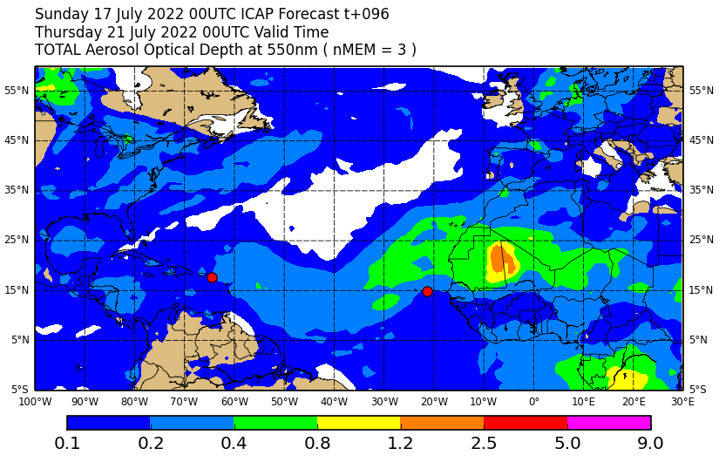
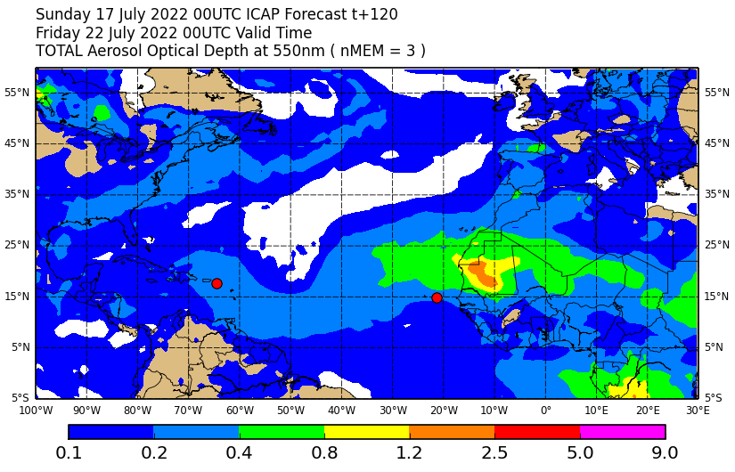
Dust and Aerosols Outlook – Days 3 & 5
(July 29 & 31, 2021)
Ensemble mean total AOT (day 3)
Ensemble mean total AOT (day 5)

Slide 19
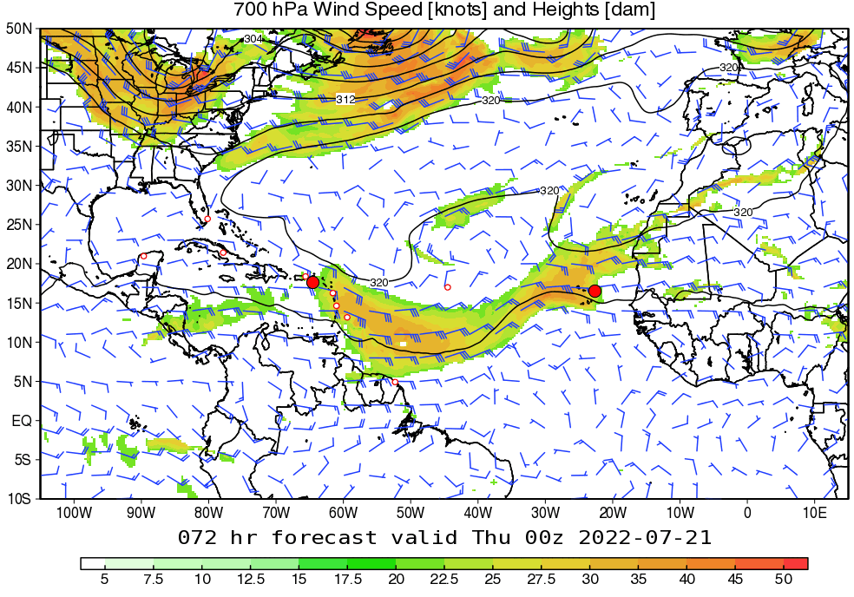
Dynamical Outlook – Days 3-5
(July 30- Aug. 1, 2021)
700mb Winds and Geopotential Height - GEOS

Slide 20

Summary

